Slide 1
MSc Project
(A00033581)
Viva Presentation
Text-to-SQL System for Project Management Applications
Student Name: Md Tanzeem
Date: 02 Sept 2025
Supervisor: Kuo-Ming Chao
Industry Partner:: EZPS

Slide 2
Outline
Context
Problem Statement
Objectives
Methodology
System Architecture
Project Management
Literature Review
Implementation Highlights
Results & Performance
User Experience Testing
Comparison with Related Systems
Future Work & Extensions
Conclusion

Slide 3
Context
Field: Natural Language Processing + Database Systems
Subfield: Text-to-SQL Translation for Domain-Specific Applications
Industry Need: 73% of project managers report data accessibility barriers
Technology Trend: Large Language Models enabling practical NLP solutions
Domain Focus: Project management databases with specialized terminology
Gap Identified: While general Text-to-SQL systems exist, domain-specific solutions for project management remain limited, creating opportunities for specialized optimization

Slide 4
Problem Statement - WHY
What: Lack of direct database access for non-technical project stakeholders
Who: Project managers, business analysts, stakeholders without SQL expertise
Where/When: Daily project management workflows requiring data insights
Impact: Time-consuming dependency on technical staff
Core Issues:
Communication bottlenecks delaying decisions
Limited data exploration capabilities
Reduced operational efficiency
Dependency on technical intermediaries

Slide 5
Objective - WHAT
SMART Objective: To develop and evaluate a Text-to-SQL system enabling natural language queries for project management databases with ≥85% accuracy, completed within 15 weeks.
Specific: Natural language to SQL translation for project management
Measurable: Target 85% query accuracy, 4.0/5.0 user satisfaction
Achievable: Using proven technologies (Google Gemini, LangChain)
Relevant: Addresses real industry need for database accessibility
Time-bound: 15-week development and evaluation timeline

Slide 6
Methodology - HOW
Approach: Agile development with 5 sprint structure
Technology Stack: Python Flask + Google Gemini 2.0 + LangChain
Agent Pattern: ReAct (Reasoning and Acting) for improved accuracy
Database: SQLite with project management schema
Evaluation: Technical metrics + user experience testing
Why These Choices?
Google Gemini: State-of-the-art language understanding
LangChain: Robust framework for SQL agent development
Flask: Lightweight, suitable for prototype and production

Slide 7
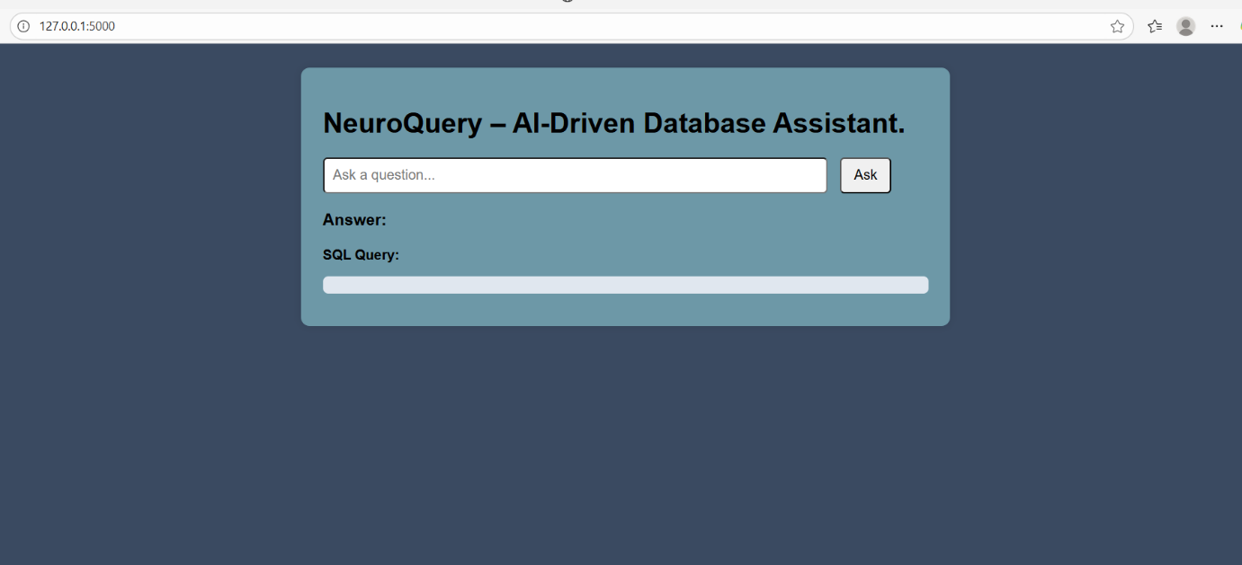
System Architecture
System Architecture
Presentation Layer Web Interface
HTML/CSS
Responsive Design
Application Layer
Flask Web Server
RESTful API
Session Management
Processing Layer Google Gemini 2.0
LangChain Framework
ReAct Agent
Domain Knowledge
Data Layer SQLite Database
Project Management Schema
SQLDatabaseToolkit

Slide 8
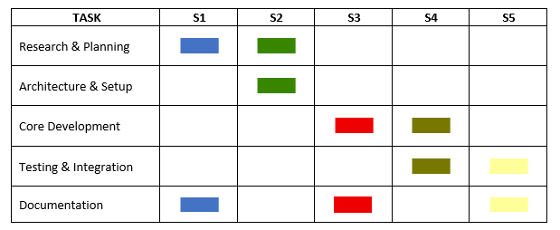
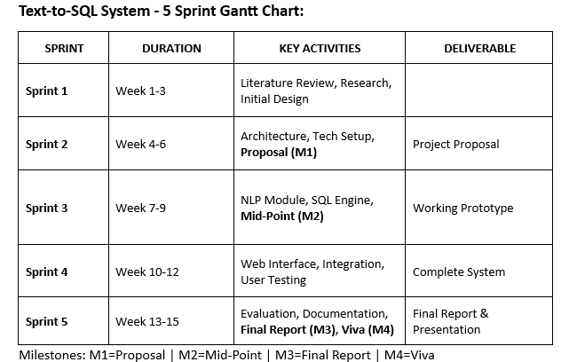
Project Management

Slide 9
Literature Review
Literature Review Findings:
Text-to-SQL Evolution: Rule-based → Statistical → Transformer-based
Current SOTA: Large Language Models showing superior performance
Key Benchmarks: Spider dataset, Seq2SQL, SQLNet achievements
Research Gap: Limited domain-specific solutions for business applications
Critical Insight: While academic systems achieve 87-92% accuracy on general benchmarks, domain-specific optimization for project management terminology remains underexplored, presenting opportunity for specialized solutions.

Slide 10
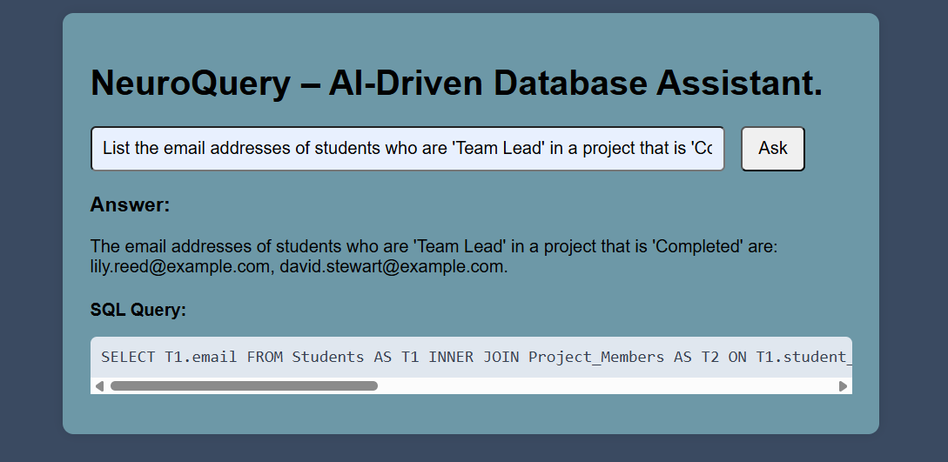
Implementation Highlights
System Implementation
NLP Module: Domain-specific prompt engineering for project terminology
SQL Generation: ReAct pattern with schema-aware query construction
Error Handling: Graceful failure recovery with user-friendly messages
Web Interface: Intuitive design for non-technical users
Example Query Translation:

Slide 11
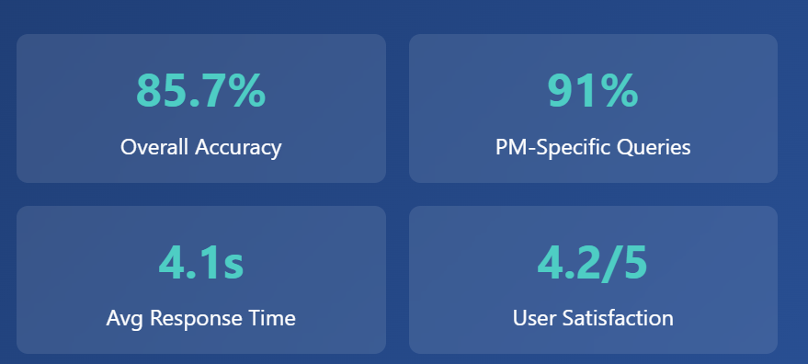
Results & Performance
Results & Performance
Key Achievement: 91% accuracy on project management-specific queries compared to 65% industry average for general systems - demonstrating clear value of domain specialization.

Slide 12
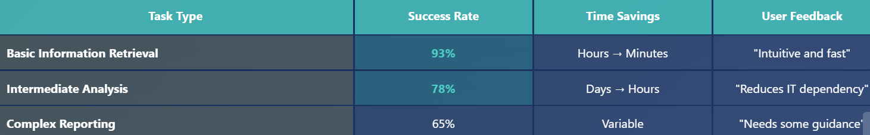
User Experience Testing
Participants: 15 project management professionals
Demographics: 8 PMs, 4 Analysts, 3 Senior Stakeholders
Success Rates: 93% basic queries, 78% intermediate analysis
Recommendation: 87% would recommend to colleagues

Slide 13
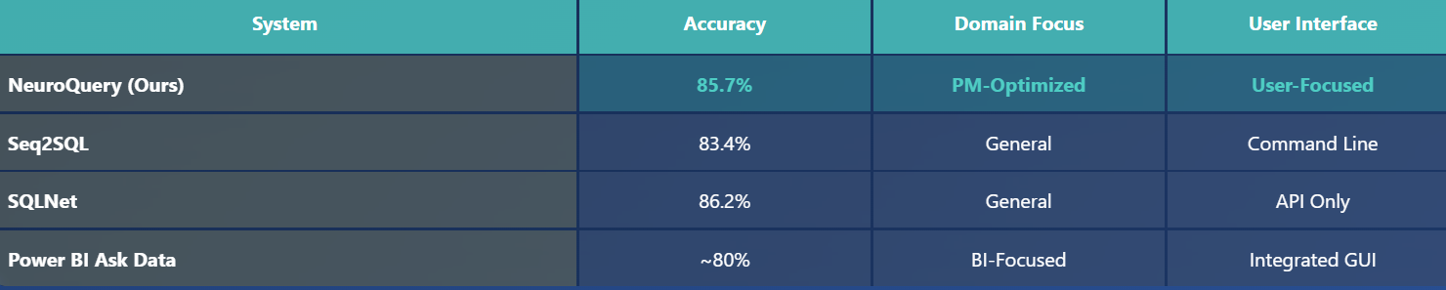
Comparison with Related Systems
Unique Contributions:
Domain-specific optimization for project management
Comprehensive user experience evaluation
Practical deployment considerations

Slide 14
Future Work & Extensions
Technical Enhancements
Multi-turn conversation support
Advanced visualization generation
Cross-database compatibility
User Experience Mobile application development
Collaborative query sharing
Personalization features
Domain Expansion
CRM and supply chain domains
Industry-specific adaptations
Platform integrations (Jira, MS Project)

Slide 15
Conclusion
Objective Achievement: Exceeded 85% accuracy target (achieved 85.7%)
Domain Value: 91% accuracy on PM-specific queries vs. 65% industry average
User Validation: 87% recommendation rate from 15 professionals
Timeline Success: All milestones delivered on schedule
Key Learnings:
Domain-specific optimization significantly improves performance
User experience equally important as technical accuracy
Modern LLMs enable practical business AI applications
Impact: NeuroQuery demonstrates that advanced AI can be successfully adapted to solve real business problems while empowering non-technical users to access critical data independently.

